Slide 1
Alphabet Flip Chart

Slide 2
Directions:
Say the letter out loud.
Name the picture that starts with that letter.
Say the sound of that letter out loud.
Think of other words that start with that letter.

Slide 3
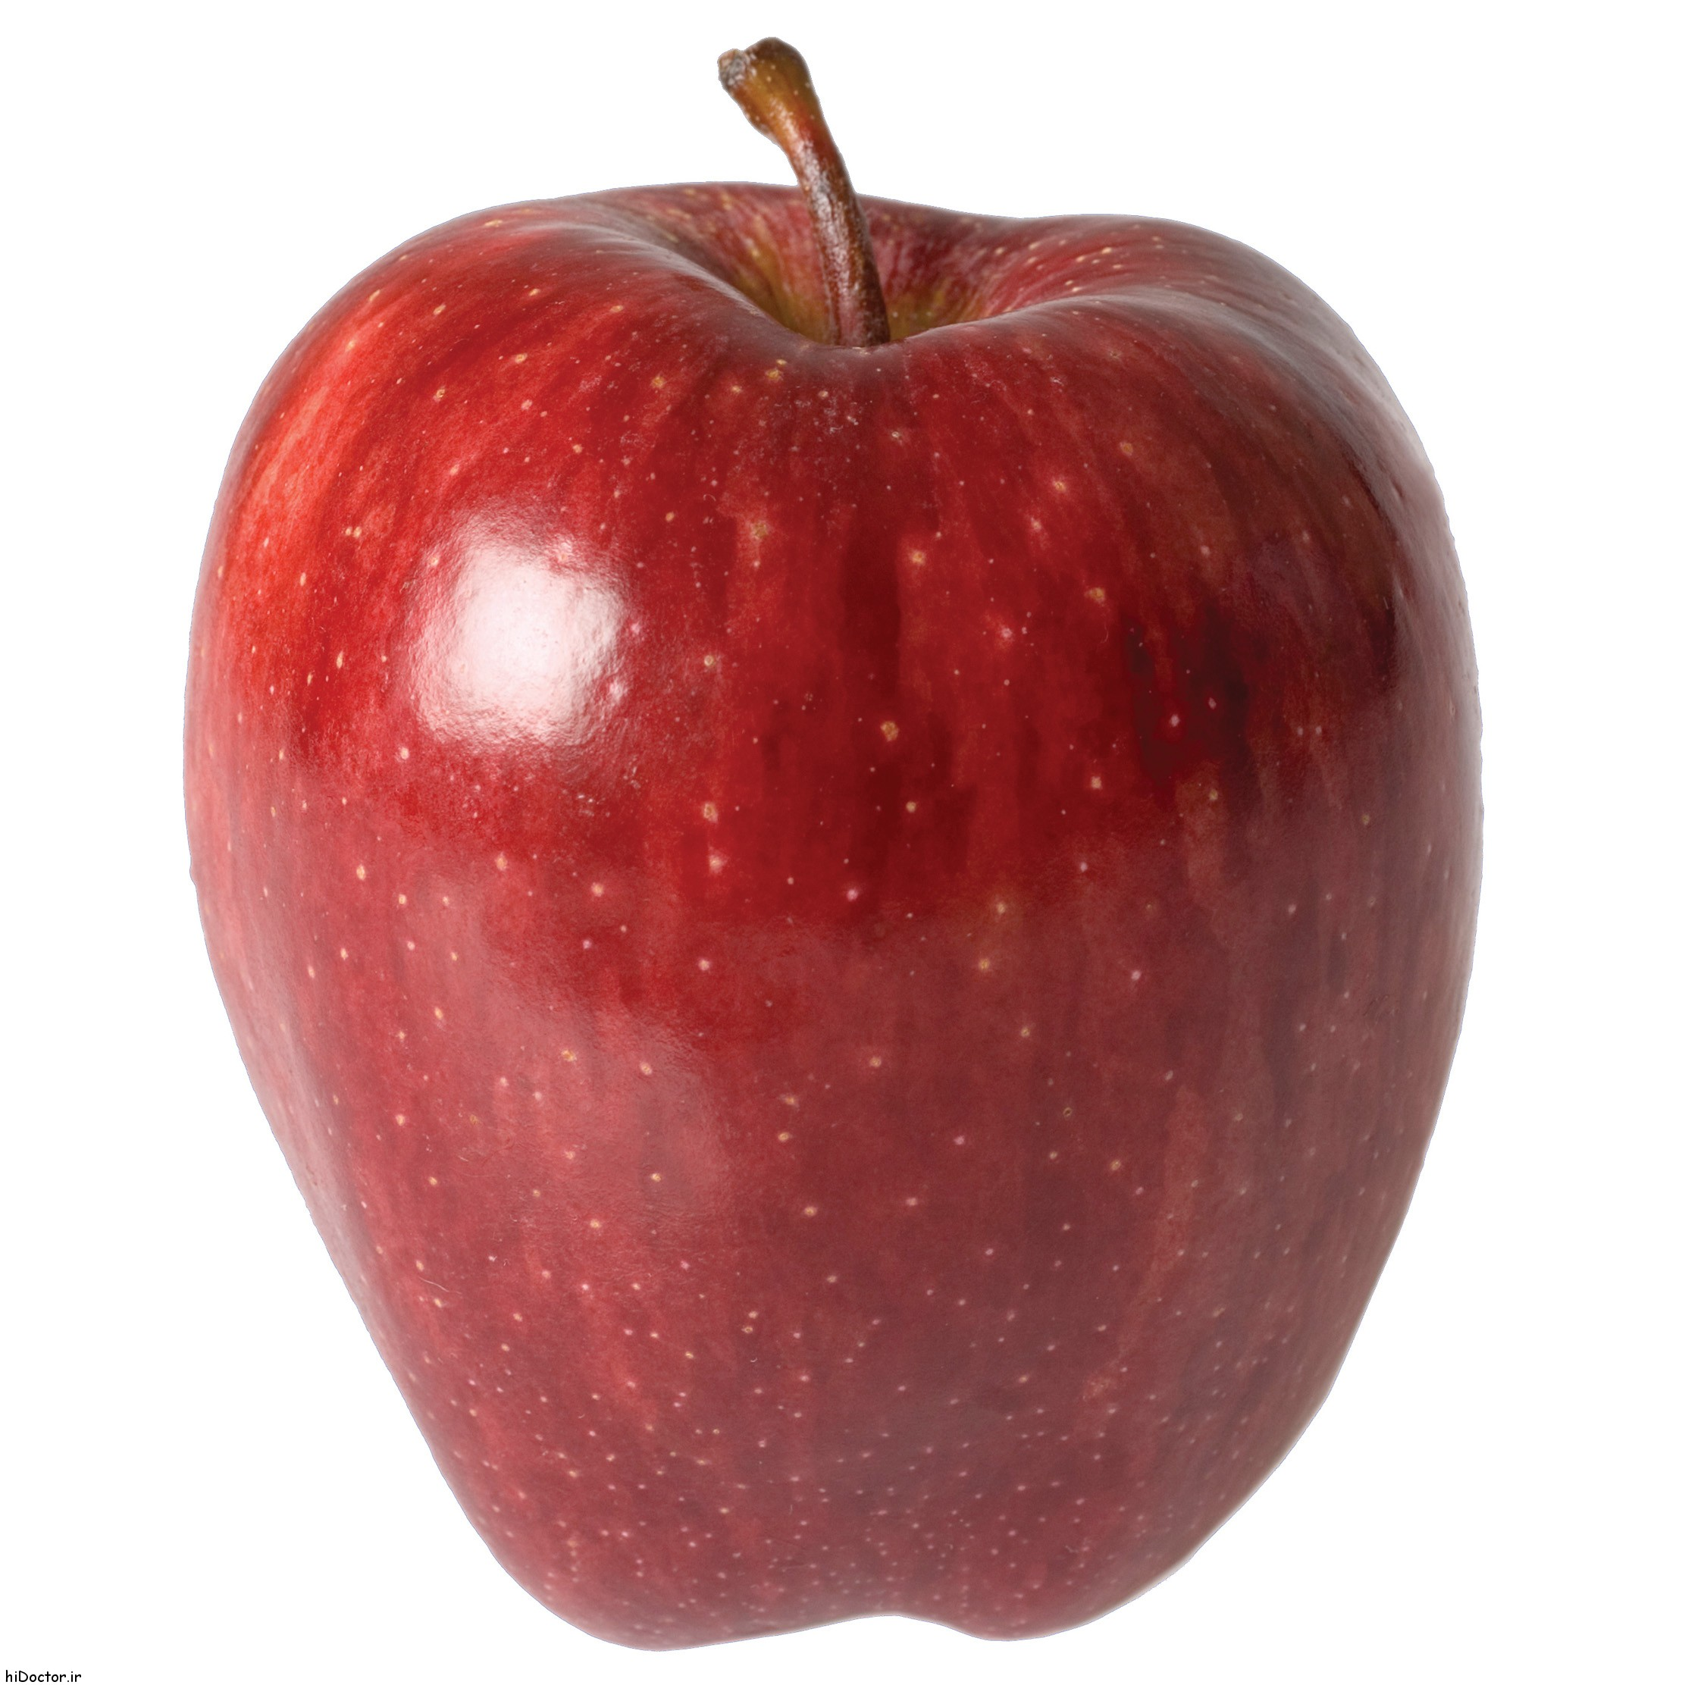
Aa
Apple
Ah

Slide 4
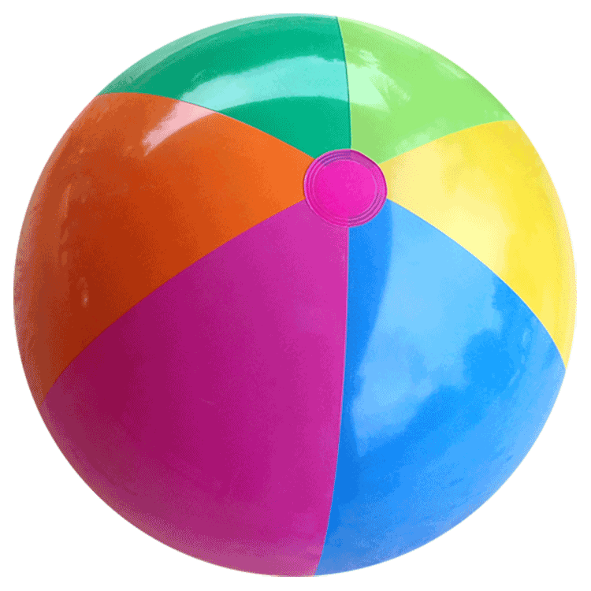
Bb
Ball
B

Slide 5
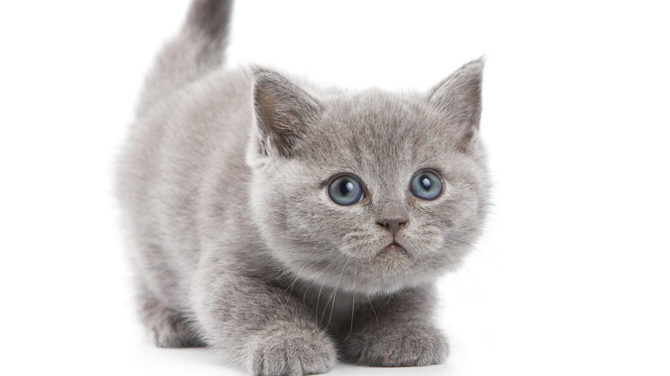
Cc
Cat
C

Slide 6
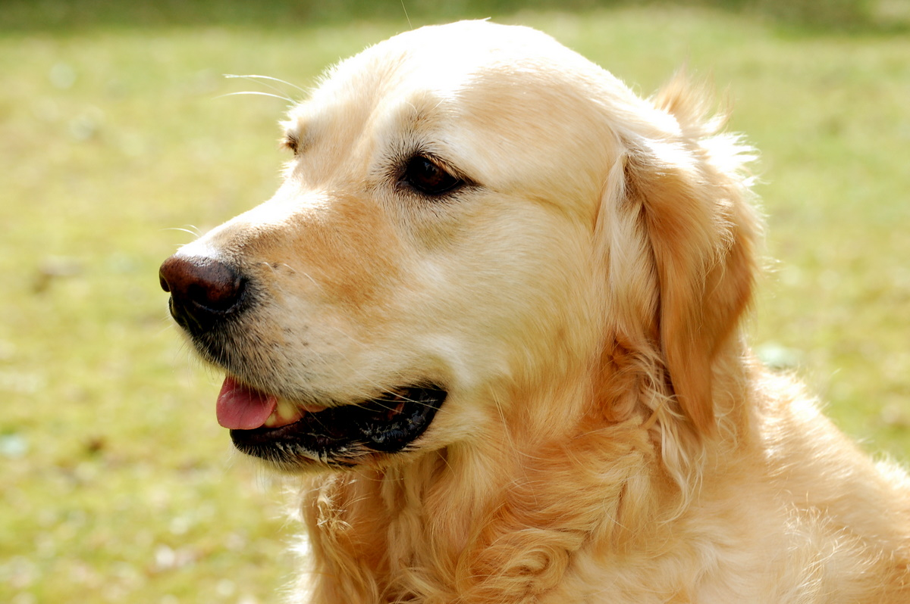
Dd
Dog
D

Slide 7
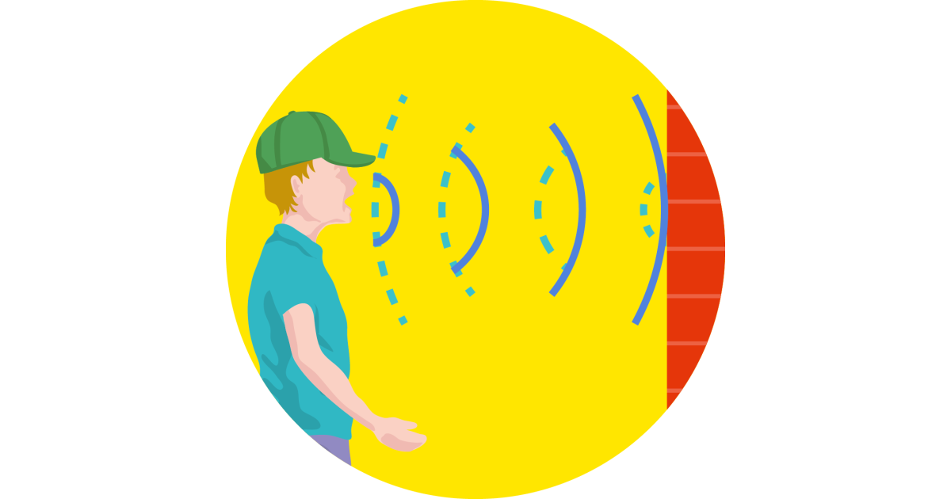
Ee
Echo
Eh

Slide 8
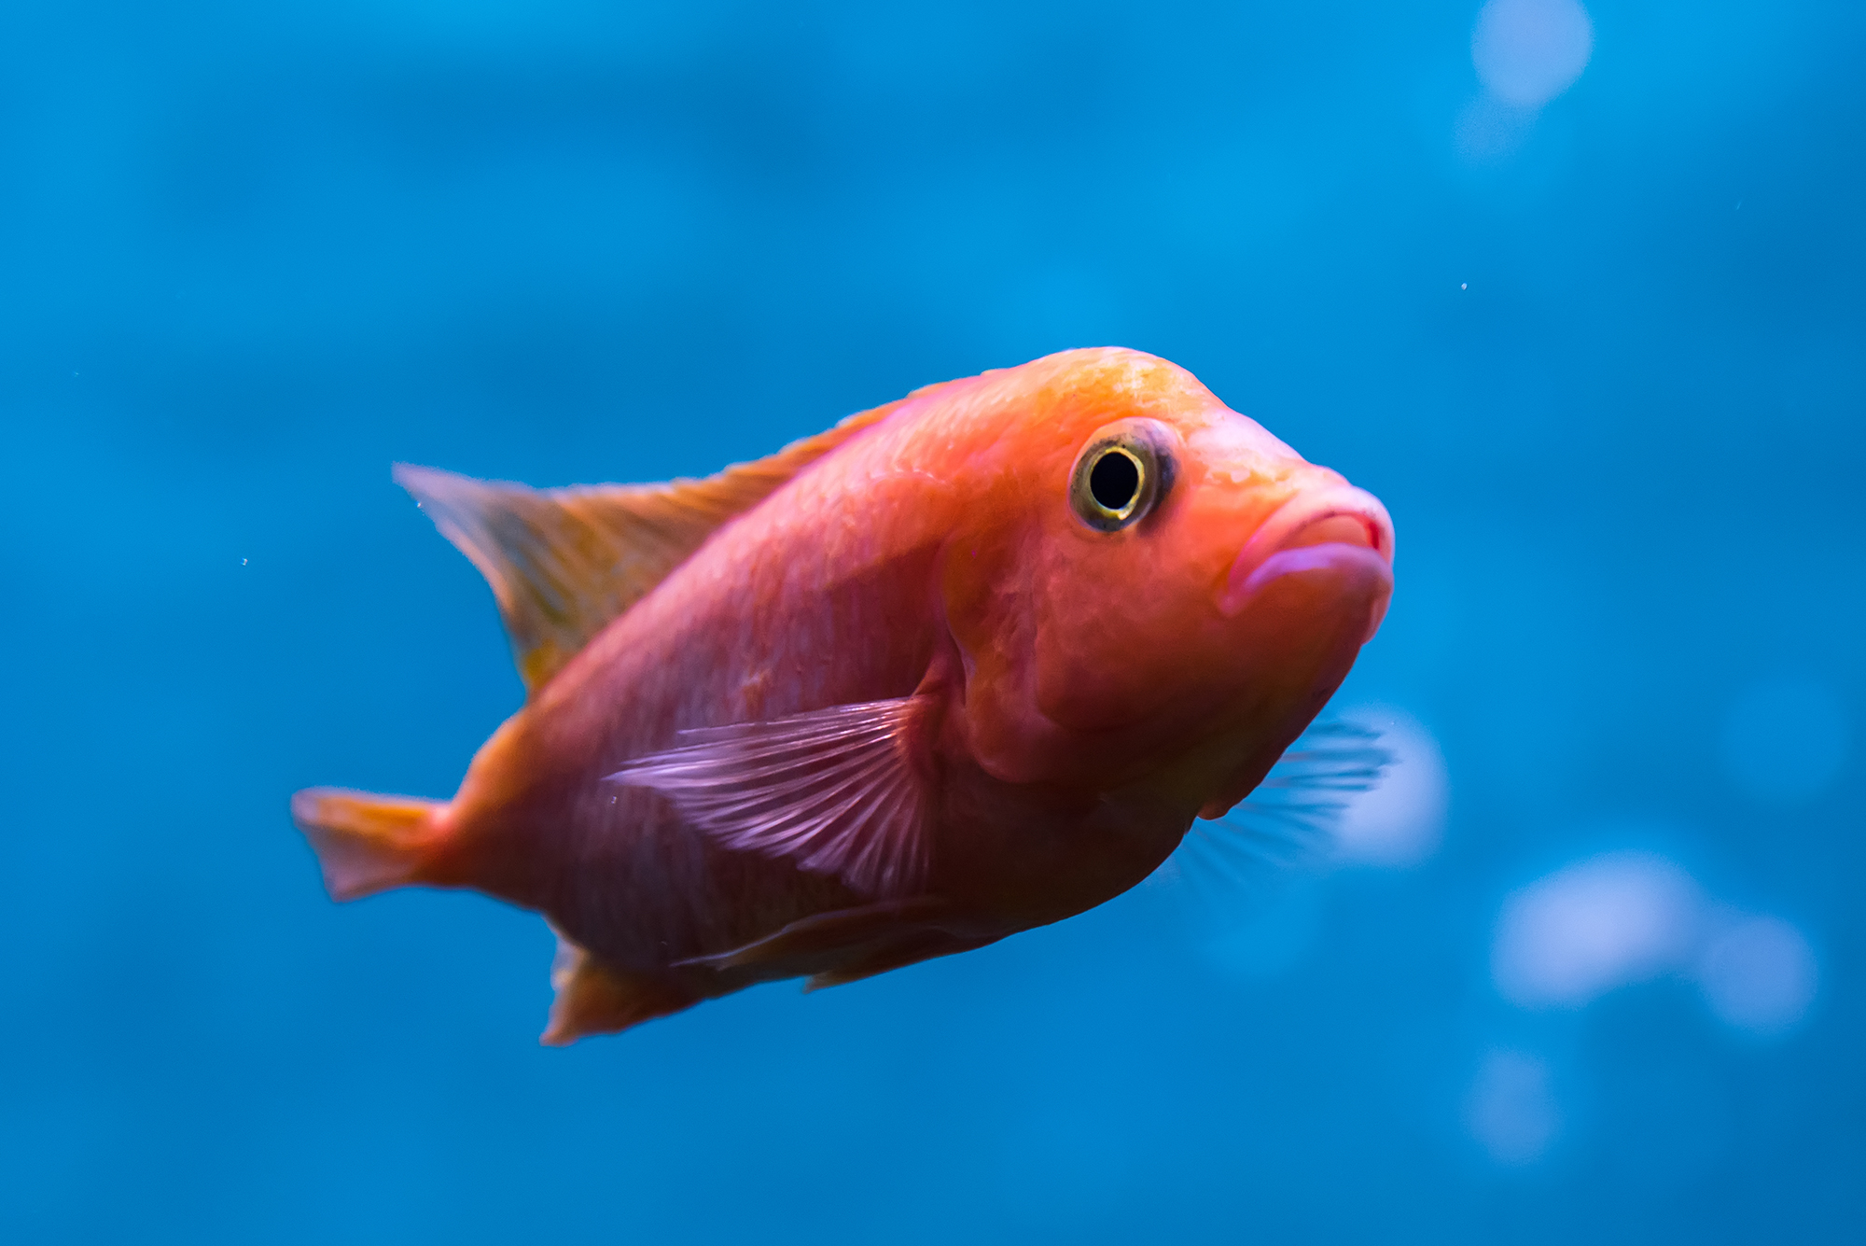
Ff
Fish
F

Slide 9
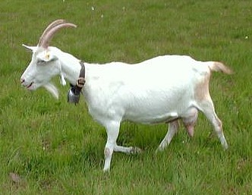
Gg
Goat
Guh

Slide 10
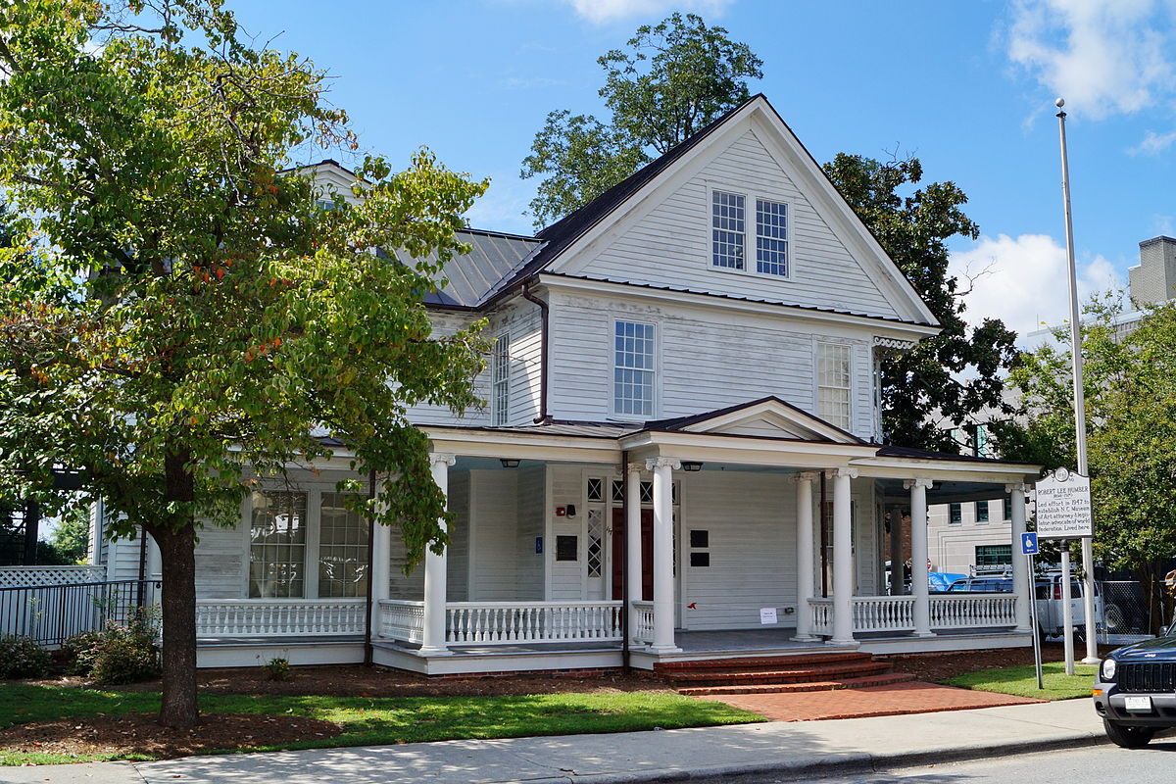
Hh
House
H

Slide 11
Ii
Itchy
Ih

Slide 12
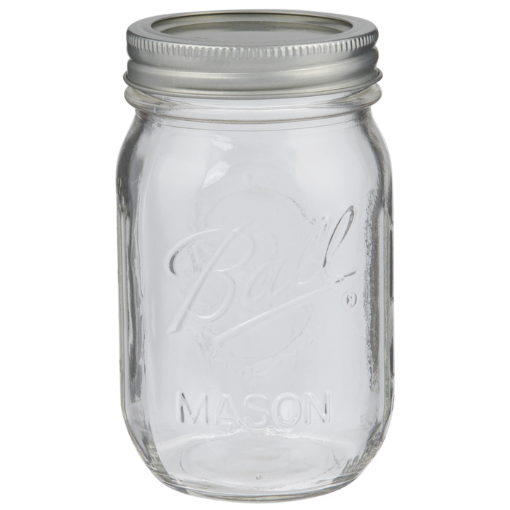
Jj
Jar
J

Slide 13
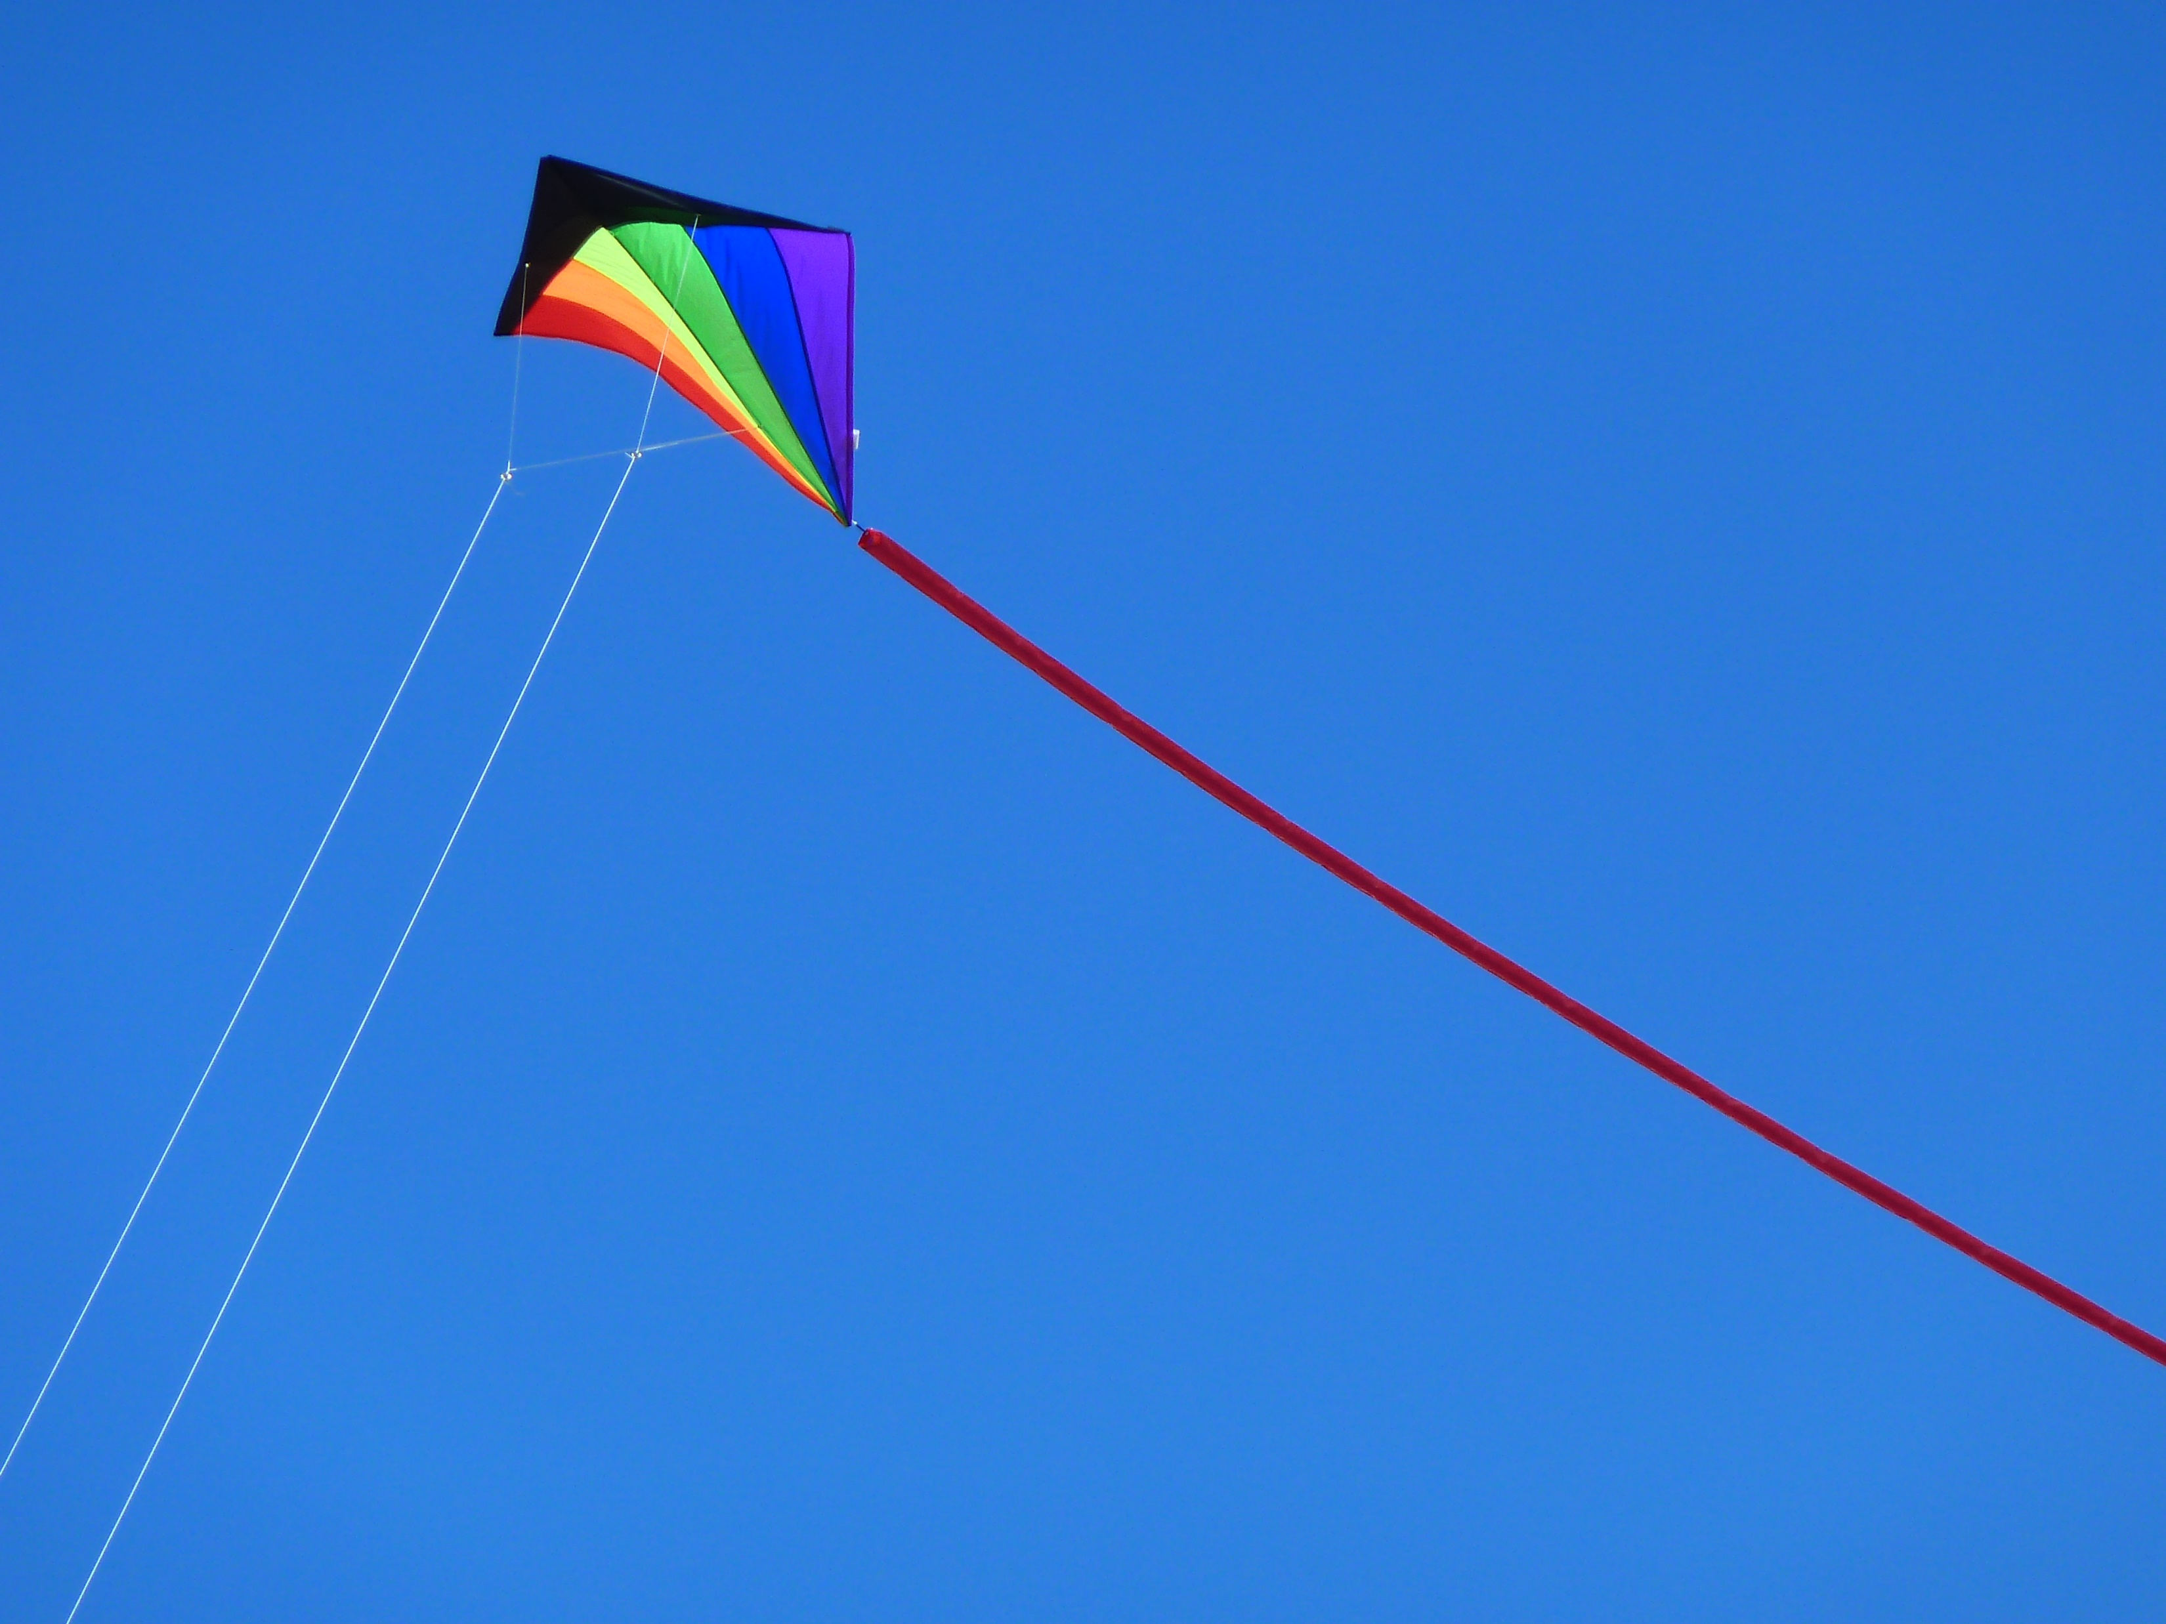
Kk
Kite
K

Slide 14
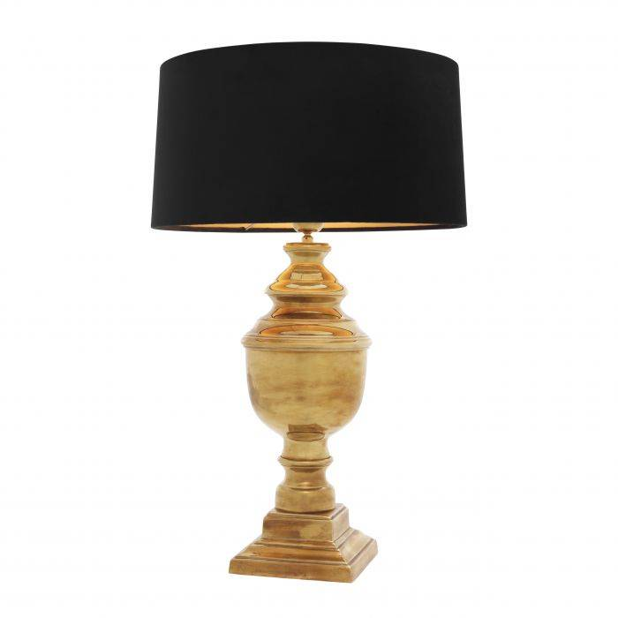
Ll
Lamp
L

Slide 15
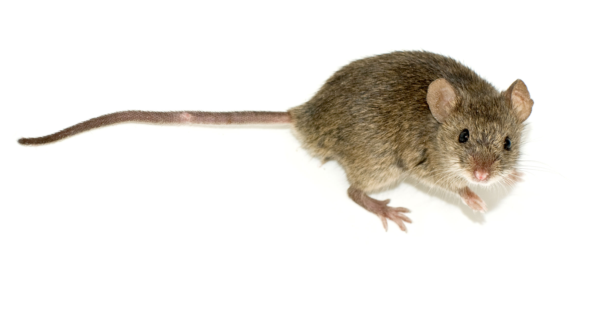
Mm
Mouse
M

Slide 16
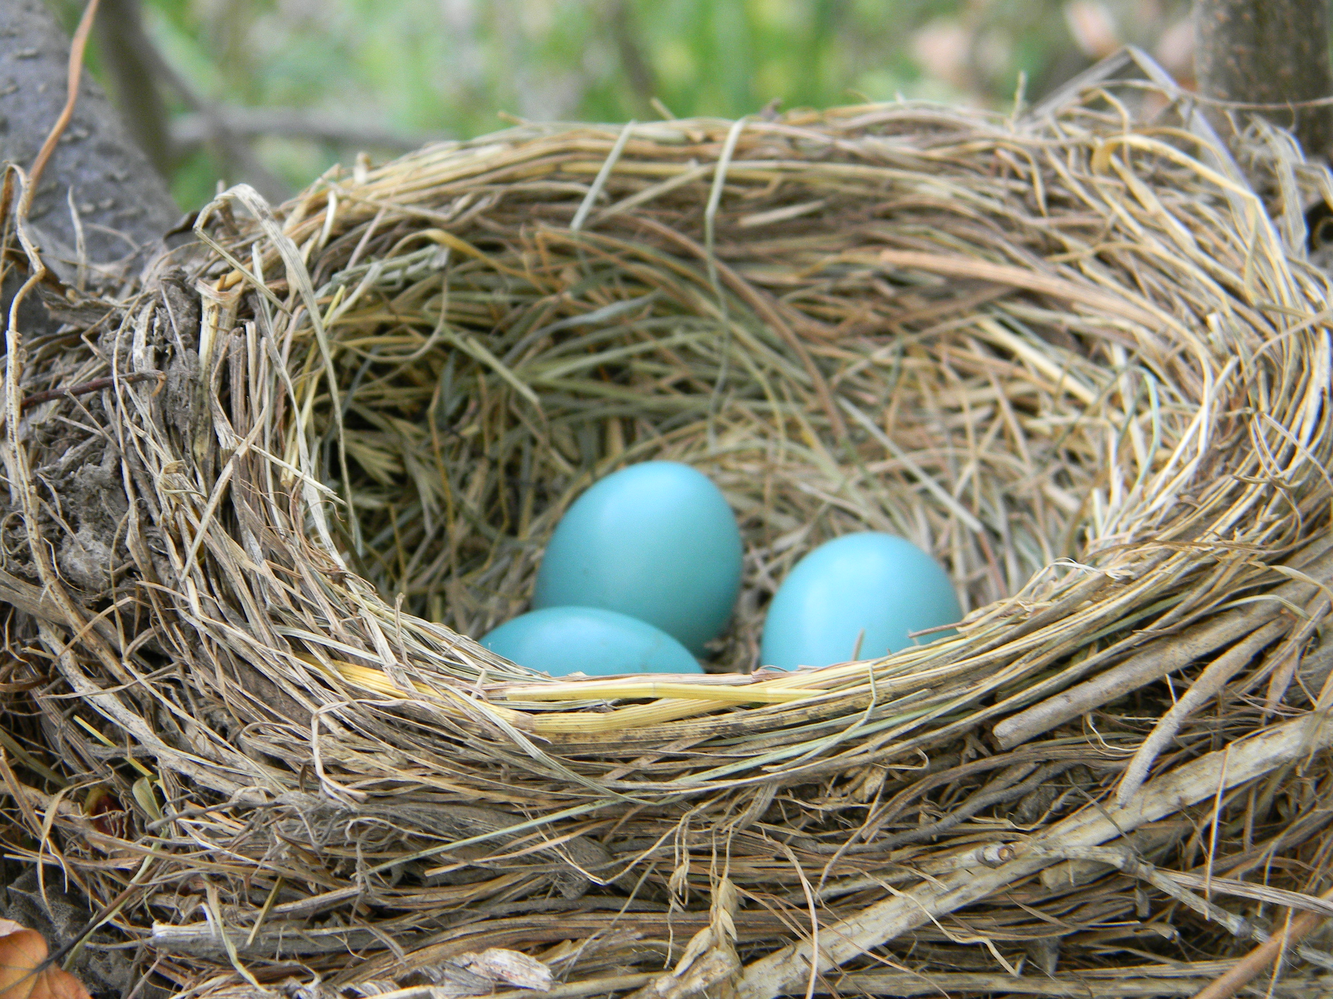
Nn
Nest
N

Slide 17
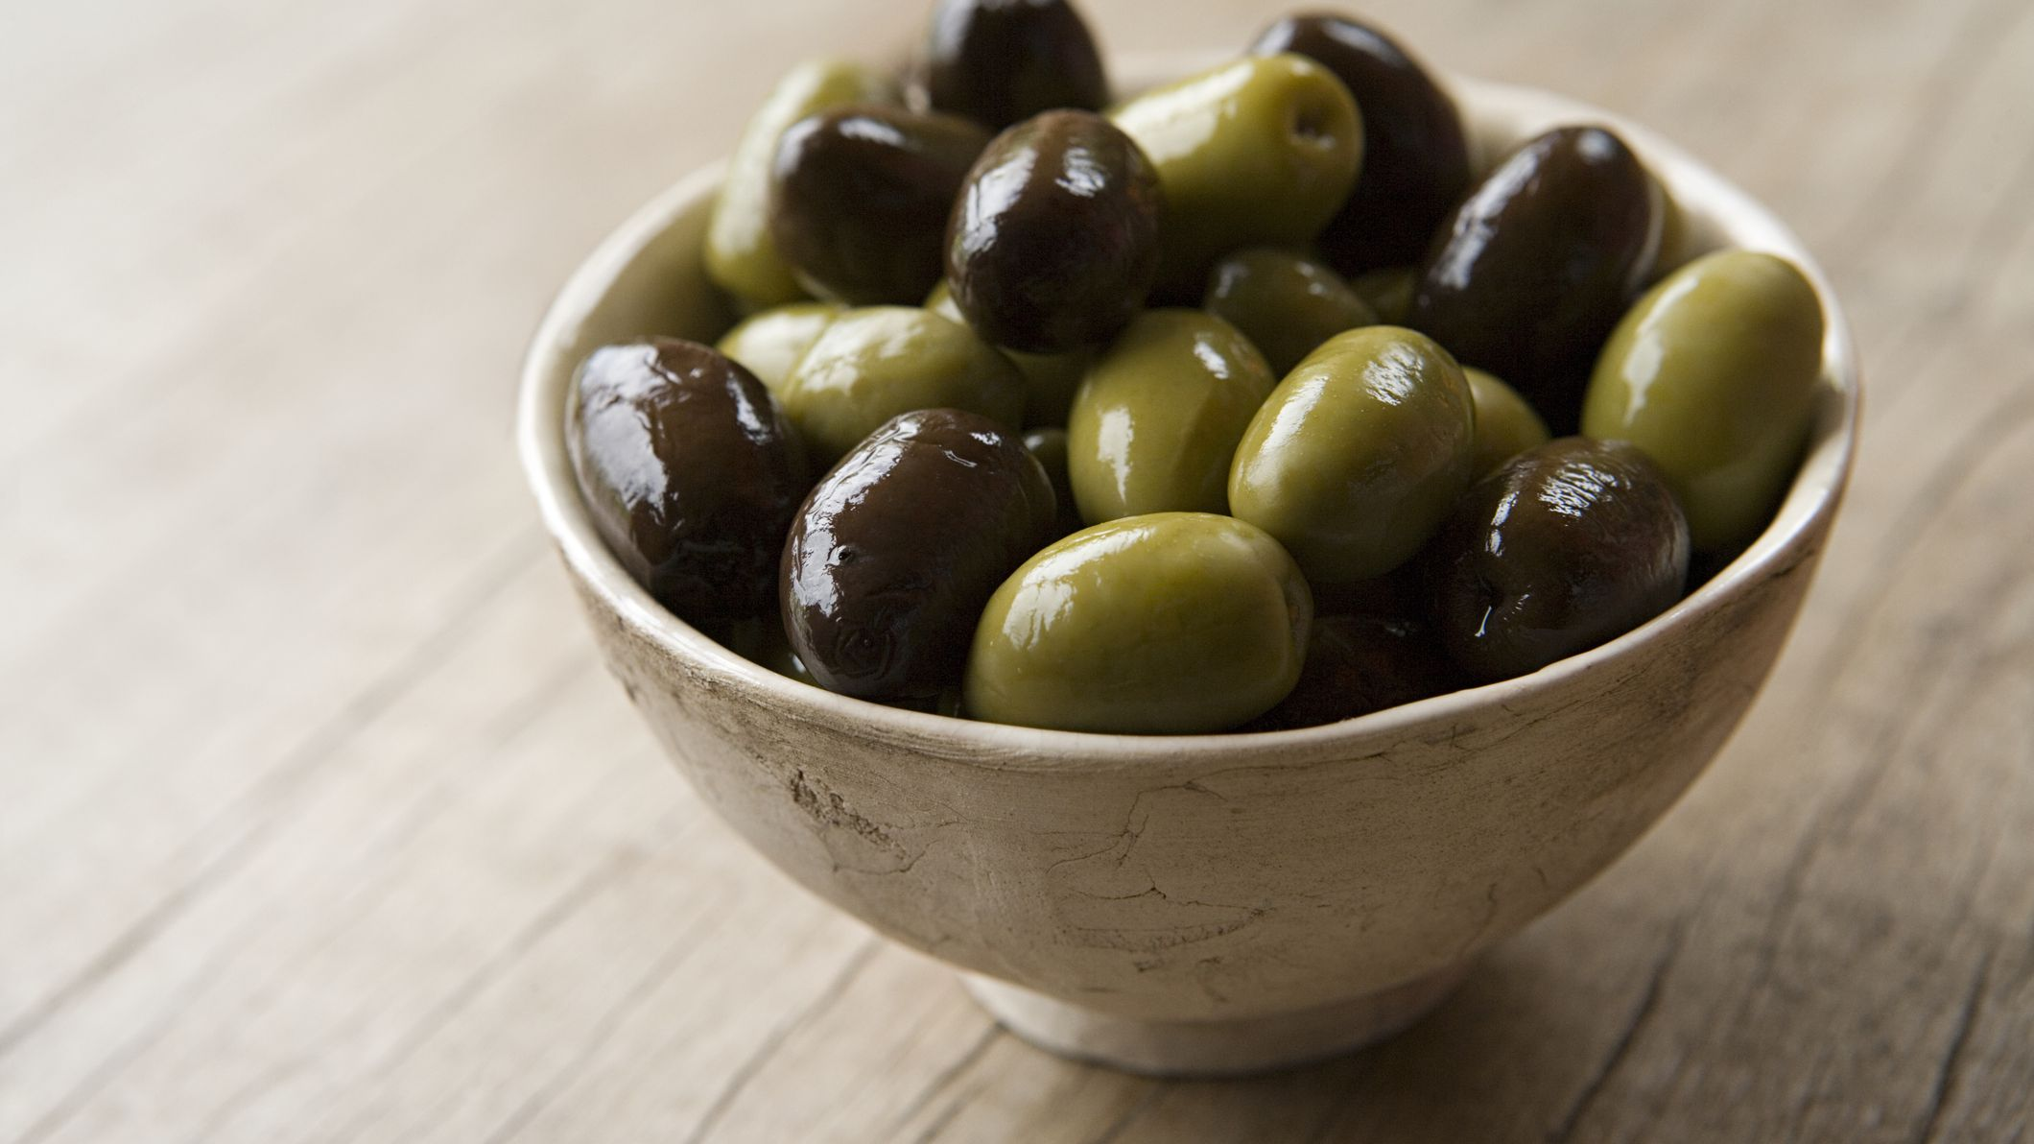
Oo
Olives
Ahh

Slide 18
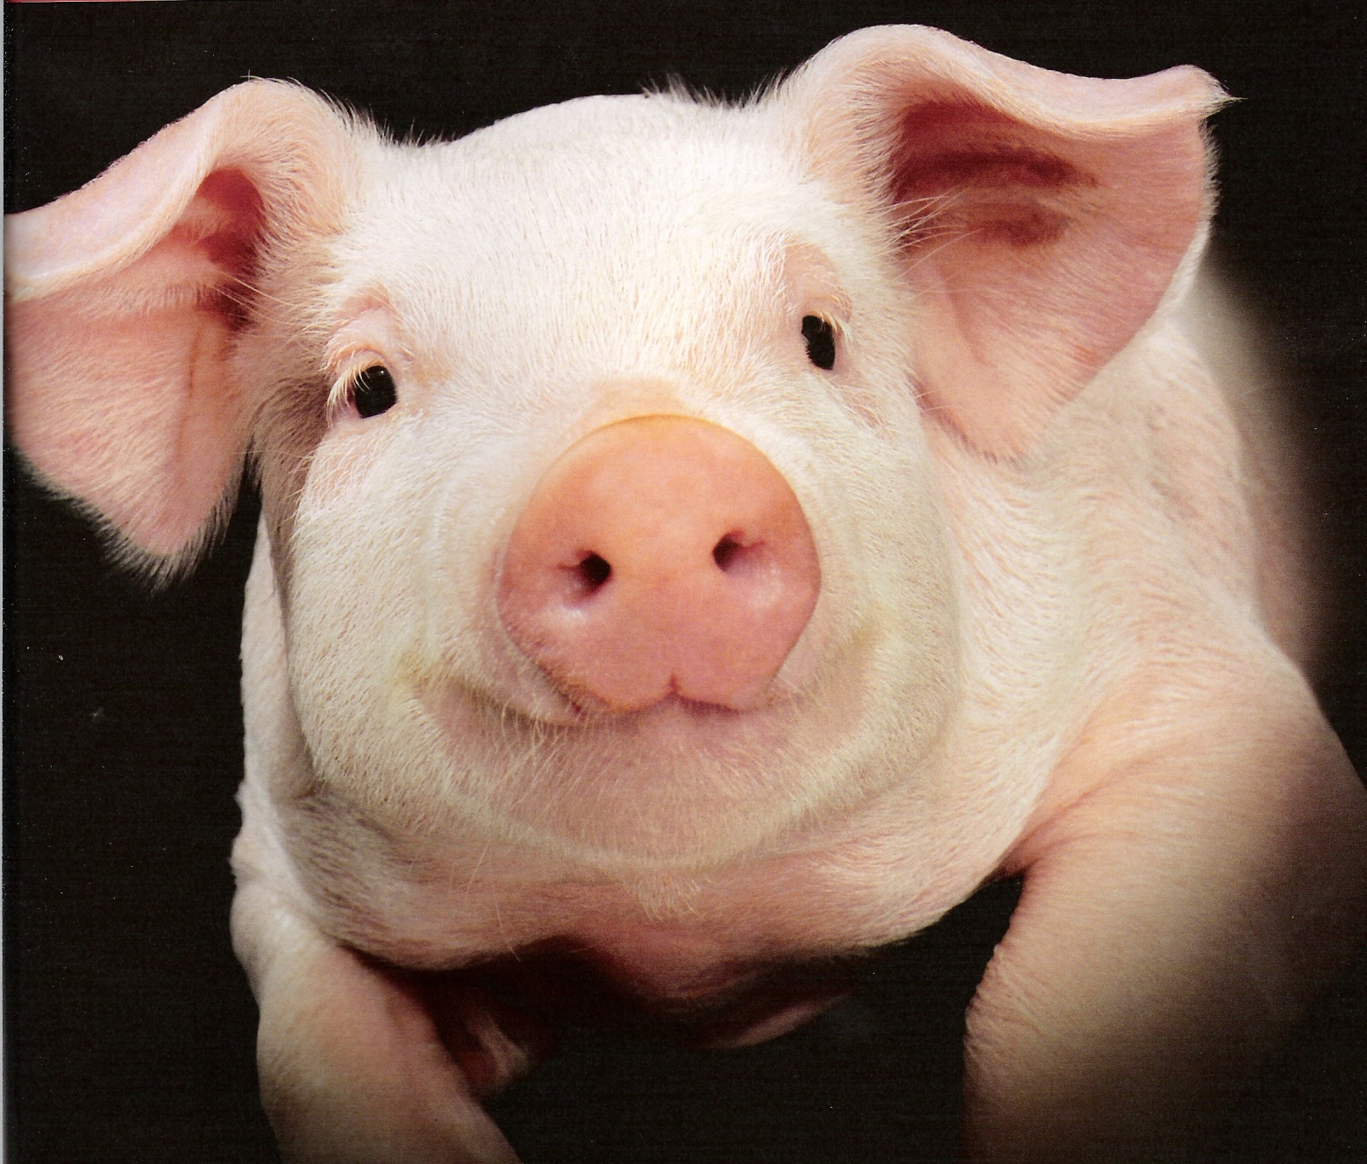
Pp
Pig
P

Slide 19
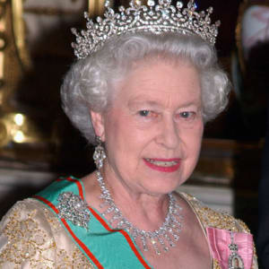
Qq
Queen
Quh

Slide 20
Rr
Rainbow
R

Slide 21
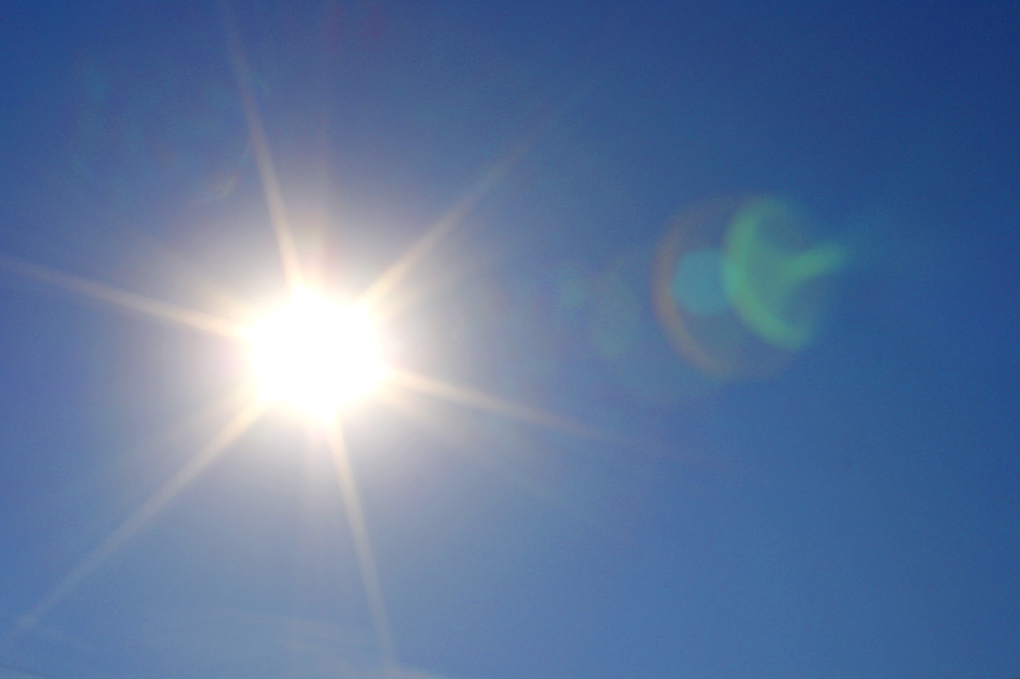
Ss
Sun
S

Slide 22
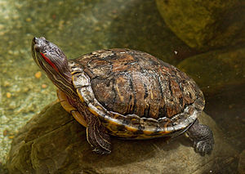
Tt
Turtle
T

Slide 23
Uu
Up
Uh

Slide 24
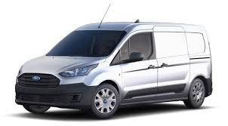
Vv
Van
V

Slide 25
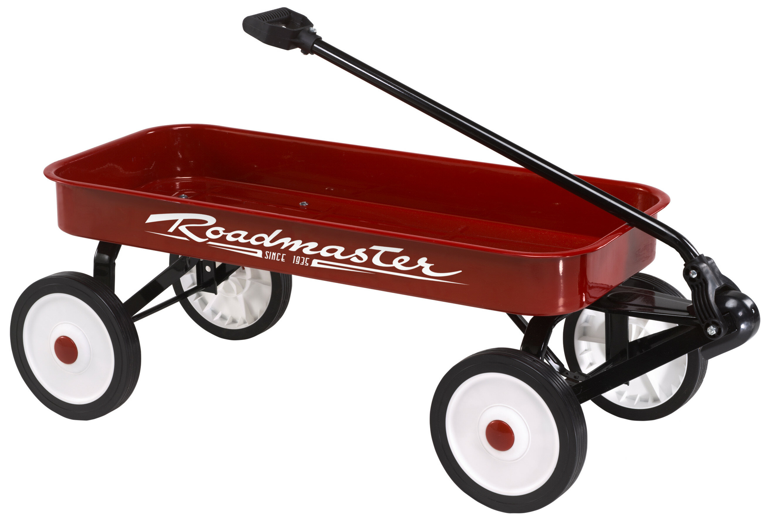
Ww
Wagon
Wuh

Slide 26
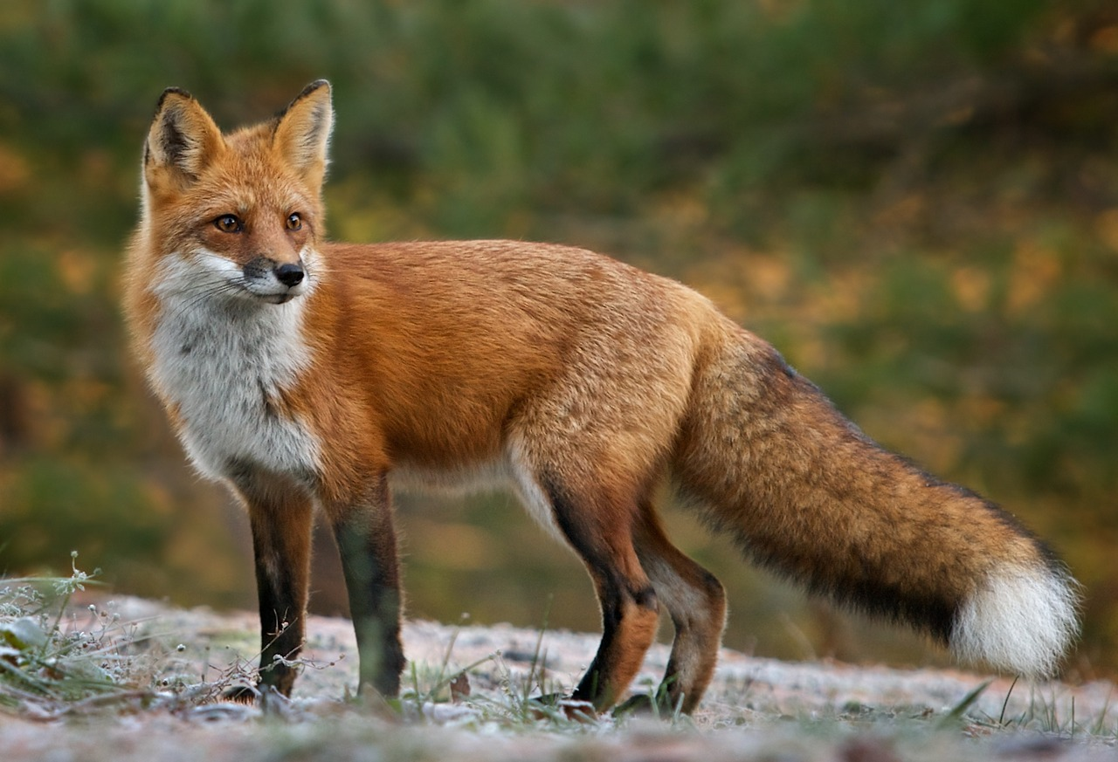
Xx
Fox
Xs

Slide 27
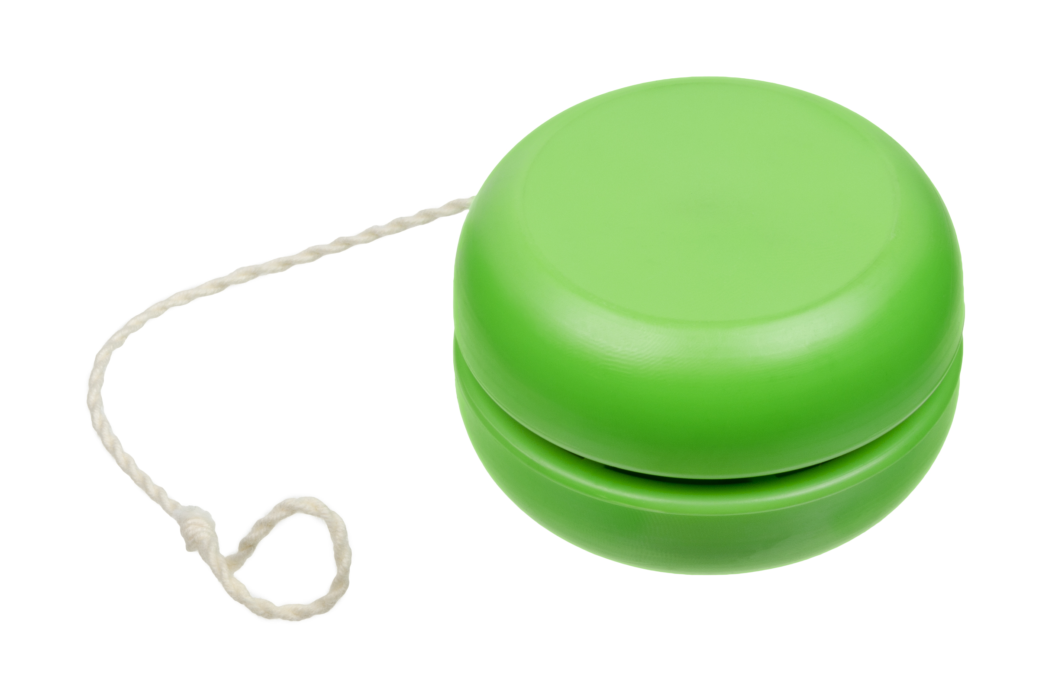
Yy
Yo-yo
Yuh

Slide 28
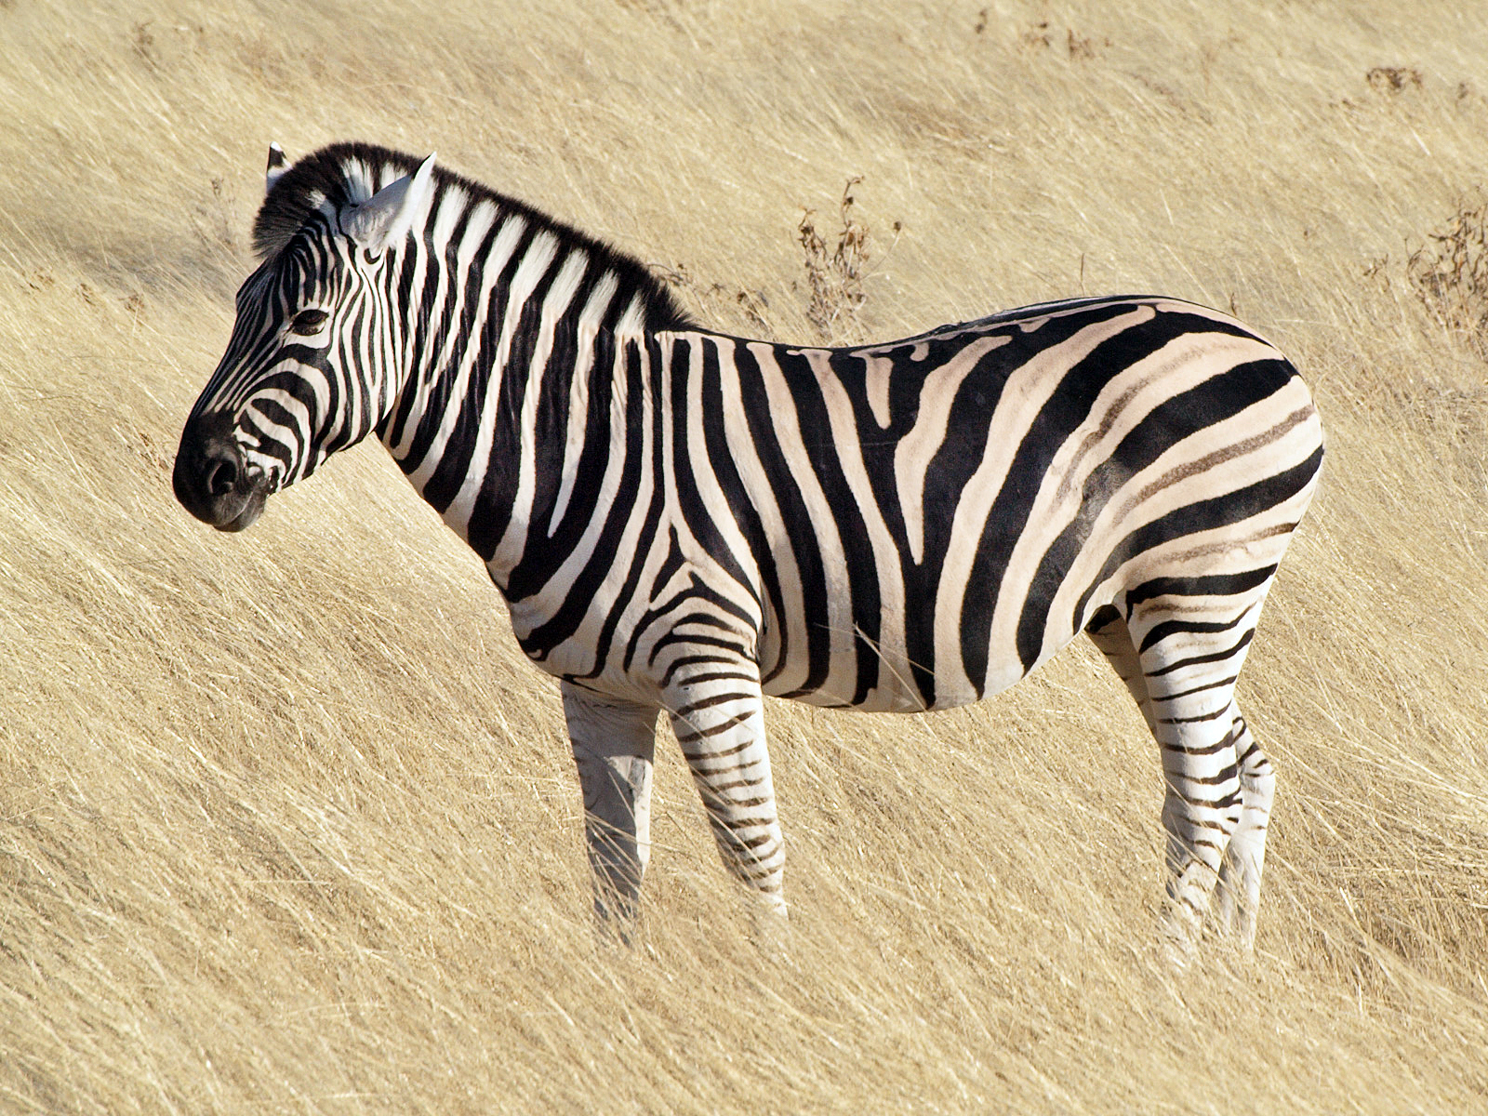
Zz
Zebra
Z

